Slide 1
Impact Alert System
Team:
David Goodman
Sharon Rabinovich

Slide 2
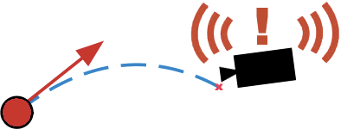
Description
Goal: Detect a ball moving towards the camera, and sound an alarm before the ball hits the camera.
References:
Computer Vision: Algorithms and Applications, by R. Szeliski
Section [8.4] - Optical flow
Monocular distance estimation from optic flow during active landing maneuvers, by F. Breugel et al.
Realtime Depth Estimation and Obstacle Detection from Monocular Video, By A. Wedel et al.

Slide 3
Detailed Description
Algorithm: track focus of expansion from optical flow
Real time
Up to 30 frames per second
Object detection and tracking
Background subtraction
Optical flow
Kalman filter
Trajectory prediction
Markov model
Parameters
Object size at known distances
Object mass
Camera size (for impact prediction)

Slide 4
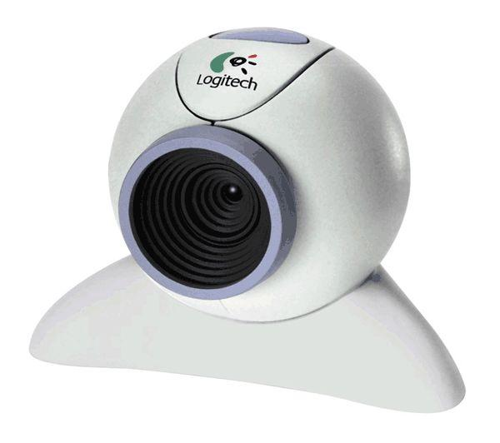
Platform
Software
Matlab/Simulink/OpenCV
Generated code to microcontroller, port to mobile, or C#
Hardware (depends on performance of simulation)
Camera
PC/Mac, Microcontroller, or Mobile
Power Supply
Special ball (bright green)

Slide 5
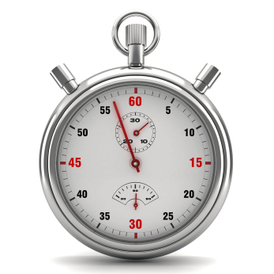

Challenges
Implementation in real time
Response time
Direction
Predicted trajectory

Slide 6
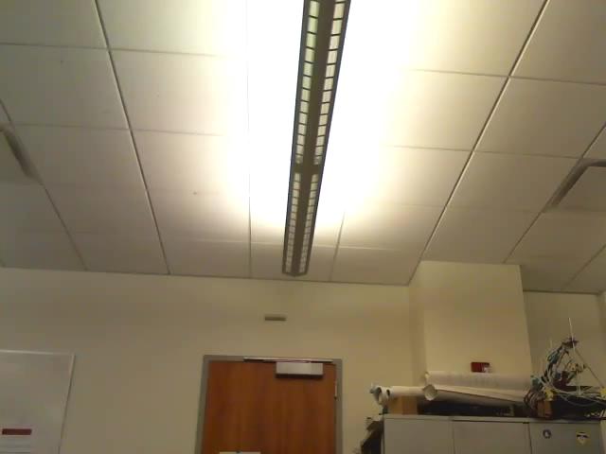
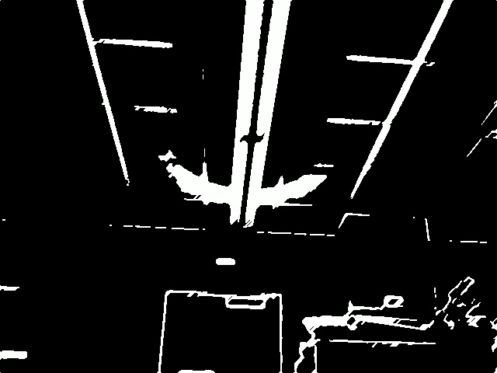
Demo - March 12
Presentation
Demonstration of tested scenarios
Live Demonstration
Audience

Slide 7
Contingency plans
In case of success
Extension for moving camera with static scene
In case of difficulties
Algorithm in Simulated environment
Port to mobile device
Port to C environment

